Slide 1
Portfolio Analysis
Rohan Pandit, Ekow Andoh, Nancy Jarman

Slide 2
Introduction
Identify behavior, evaluate performance and predict stock prices with ml techniques
Stock close prices from 12 companies
Stock data from 2009 to 2019
Assign weights to each stock

Slide 3
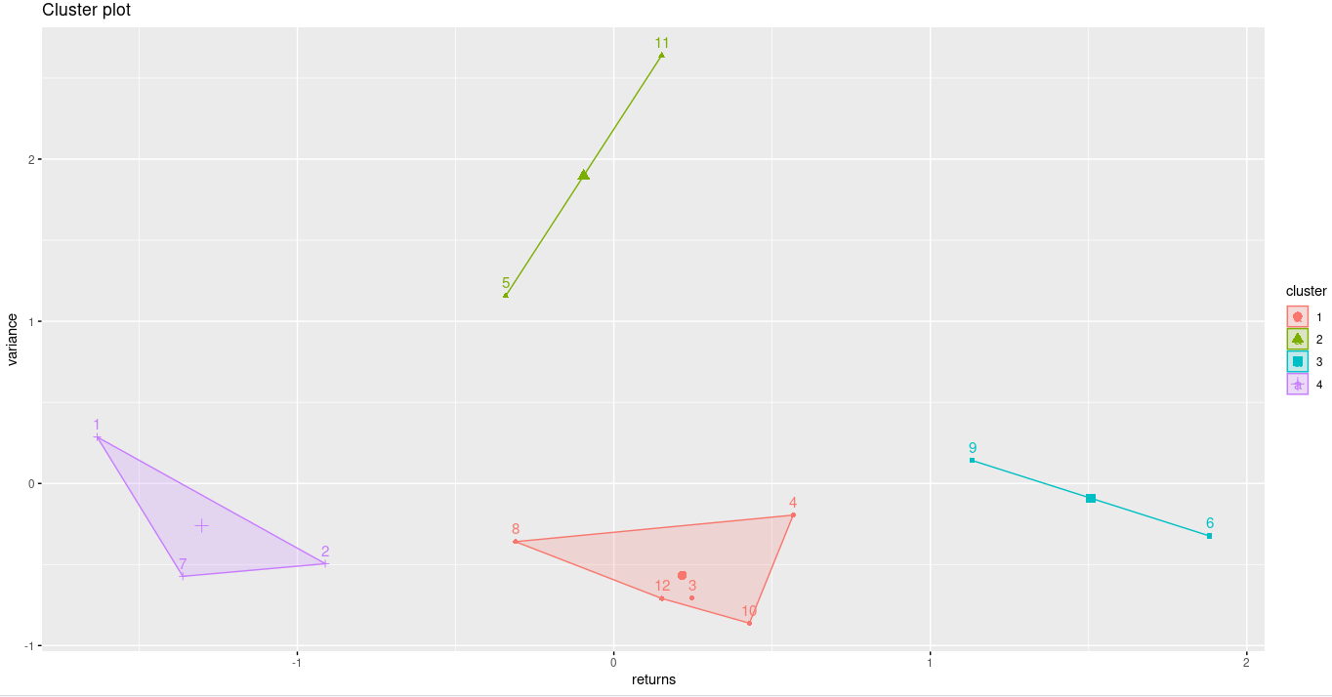
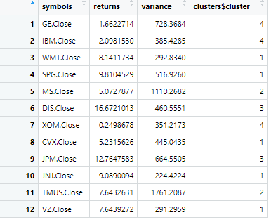
K-means Clustering
Calculated the annual average returns and annual return variance of each stock
Used silhouette method to find best number of clusters

Slide 4
Performance Analytics
Compare portfolio performance to the S&P 500
Beta = 0.907
Alpha = -0.46
Sharpe Ratio = -0.145

Slide 5
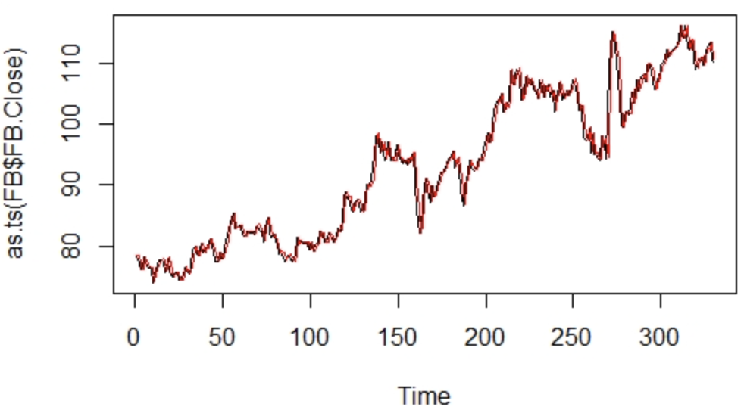
Time-Series
Used ARIMA model which is one of the most useful and accurate models in making predictions about future trends.
Our objective is to forecast the entire returns series from breakpoint onwards
This initialized a series in which it stored the actual returns and another series to store the forecasted returns.
So the ARIMA model fits the time series of the close price
After the model is built, to forecast future stock prices, forecast.arima was used to
Predict the future price of stock
And stored our prediction in a variable, fit.forecast

Slide 6
Time Series Takeaways
We need to be careful when using this result as it is most likely dominated by a number of influential observations and is not reflective of the general trend.
Our main source came from yahoo finance
Might not provide a comprehensive list of all important factors that took place over the past 10 years.
There are limitations and shortcomings that can be improved on through our data collection and further analysis.

Slide 7
Portfolio Optimization
After analyzing, we want to optimize our portfolio to have the highest expected return and lowest risk.
This was accomplished using the PortfolioAnalytics library in R.
We used the Efficient Frontier to analyze the risk-reward ratio.

Slide 8
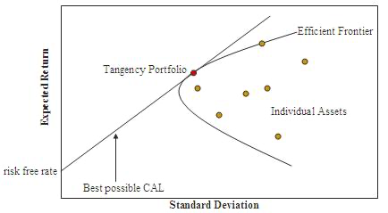
Efficient Frontier
Introduced by Nobel Laureate Harry Markowitz,
Common metric used by many investors to try and optimize a selected portfolio.
Quantifies risk vs. return.
Creates an optimal set of portfolios that give you the lowest level of risk for a selected value of expected return.
Risk is shown on the x-axis, while the expected returns are shown on the y-axis.

Slide 9
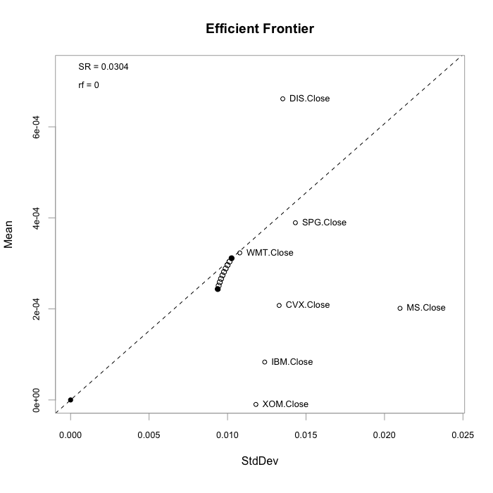
Initial Optimization
Included all stocks
Expected Return: 0.0003113
Risk Factor: 0.01026
Weights:
DIS: 0.3
GE, WMT, SPG, MS, CVX, IBM, XOM: 0.1
Takeaways:
DIS -> highest performer -> highest weight
Many stocks in bottom right (high risk, low reward)
Can we do better?

Slide 10
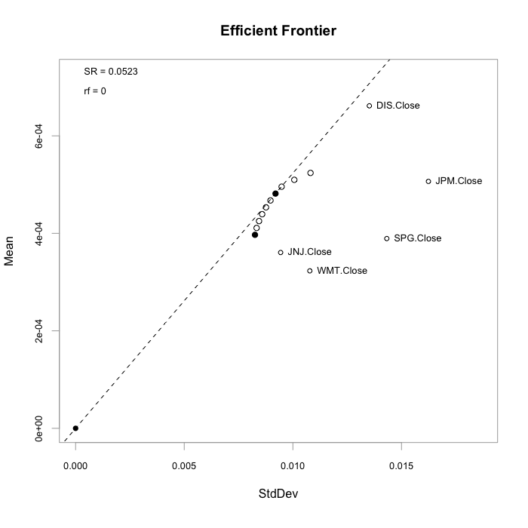
Final Optimization
Included only highest performing stocks (DIS, JPM, JNJ, SPG, WMT)
Expected Return: 0.0005119
Risk Factor: 0.01017
Weights:
WMT: 0.1
SPG: 0.1
JNJ: 0.1825
JPM: 0.2175
DIS: 0.4
Takeaways:
Higher performers given higher weights, like before (DIS highest, then JNJ and JPM, finally WMT and SPG)
Expected Return almost doubled (increased by factor of about 1.7)

Slide 11
Conclusions
Portfolio did not perform well
May be worthwhile to look into other stocks
More weight should be allocated to WMT, DIS, JPM, JNJ, SPG

